Slide 1


IEEE/RSJ International Conference on Intelligent Robots and Systems Vancouver, BC, Canada September 24–28, 2017
Design and prototyping of a magnetic actuator based permanent magnets for microbead navigation in viscous environment
Walid Amokrane, Karim Belharet, Mouna Souissi, Alexis Bozorg Grayeli and Antoine Ferreira
Laboratoire PRISME
INSA Centre Val de Loire – Université d’Orléans
Walid.amokrane@gmail.com
1
Notes:
Mes collègues sont dans l’impossibilité d’être là, je présenterai le papier à leurs place.

Slide 2
Outline
Drug delivery into a human inner ear
Existing robotic and magnetic actuator systems
Permanent magnet actuator
Experimental validation
Notes:
This presentation is divided in fifth part : First i’ll introduce the Drug delivery into a human ear, then some robotic and magnetic actuator system, The permanent magnet actuator , the experimental validation of the actuator and conclusion

Slide 3
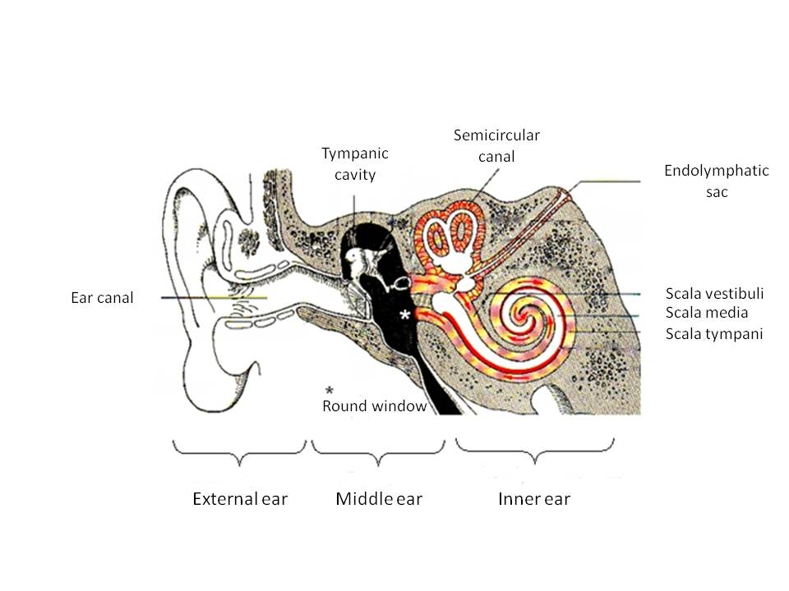
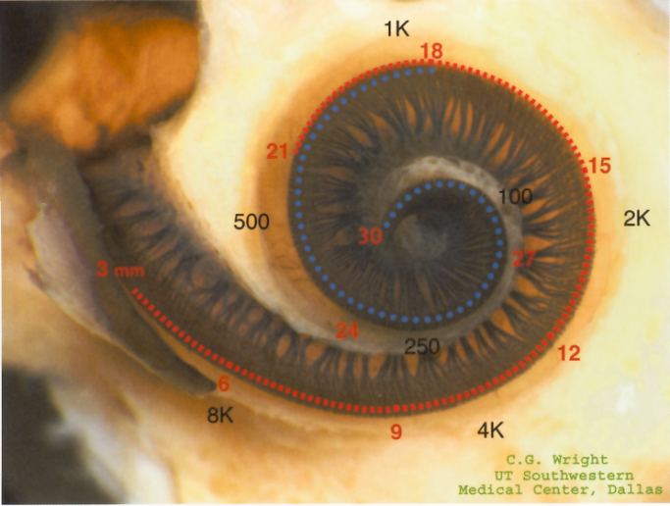
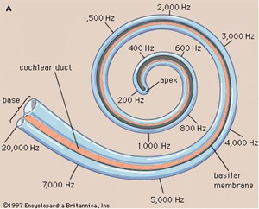
Obstacles of drug delivery
Vestibular neuritis
Impaired region
3.5 mm
Responsable of the hearing and balance sens
Blood-perilymph barrier limits exchanges and drug biodisponibilty
3
8 mm
Notes:
The goal of our reaserchs is to develop a new strategy of drug delivery in a human cochlea. To understand this issue, we must study the ear anatomy.
Tu dis que l’oreille contient 3 parties dont la cochlée / which is responsable of the hearing and balance sens. The later is given by the three semi circulaire channel, and the hearing sens by the scala vestibuli /media / tympani (voir figure )
Ensuite tu dis qu’il y’a des maladie qui touchent les zones profonde de la cochlée tel que la : Vestibular neuritis , et que la livraison de médicament est difficile à cause de : Blood-perilymph barrier limits exchanges and drug biodisponibilty

Slide 4
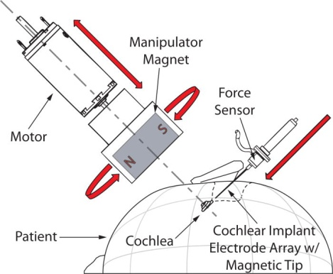
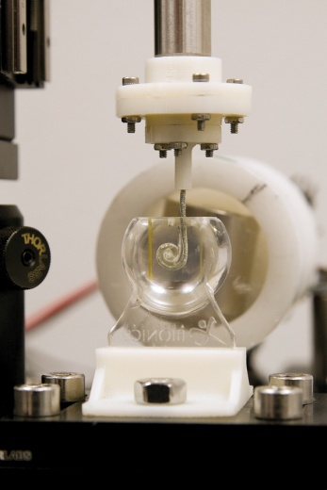
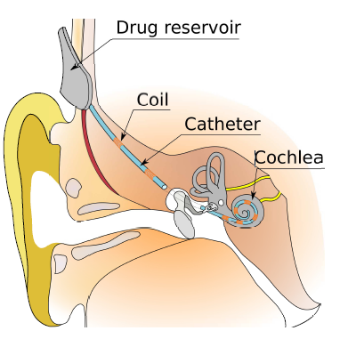
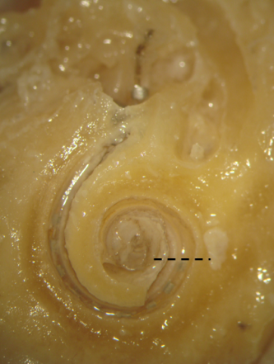
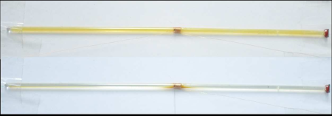
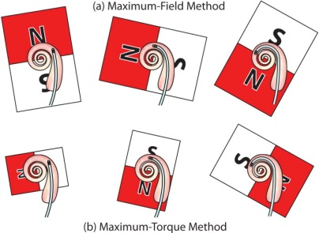
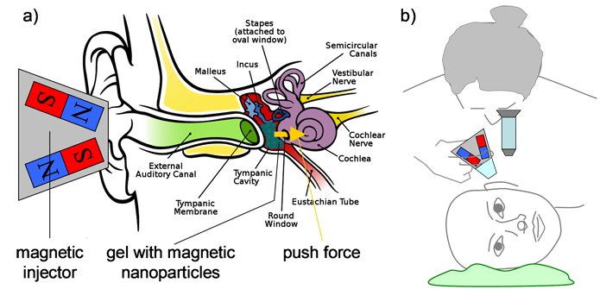
Robotic systems : State of the art
Magnetic Delivery of Nanoparticles Driven by Solenoids
(B. Nguyen, IEEE Nanomed, 2014)
Magnetic guidance of cochlear implants
(J. Abbott, J. Med. Devices, 2012)
4
Magnetic Injection of Nanoparticles into Rat Inner Ears
(B. Shapiro, IEEE Trans. Magnetics, 2013)
Notes:
Plusieurs plateformes mzgnétique ont étét utilisé pour delivrer des particules magnétique dans l’oreille.

Slide 5
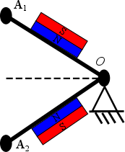
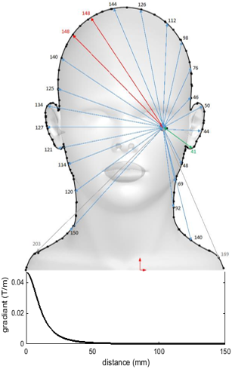
Using a two permanent magnets actuator
Capable to generate both magnetic attractive and pushing force on the same axis
Use of less bulky magnet
Increasing the magnetic gradient and force
Exposure time is significantly reduced
Lagrangian point 1
Lagrangian point 2
𝜃
Attractive force 1
Pushing force
Attractive force2
x
Right ear
Left ear
5
Notes:
Tu expliques ici le push and pull normalement en fonction de l’angle Theta
Tu dis qu avec un seul aimant il est difficilement possible de tirer les particules de l’oreille gauche car la force diminue avec la distance (voir la figure) et que le system a 2 aimants permet de créer une force plus importante

Slide 6
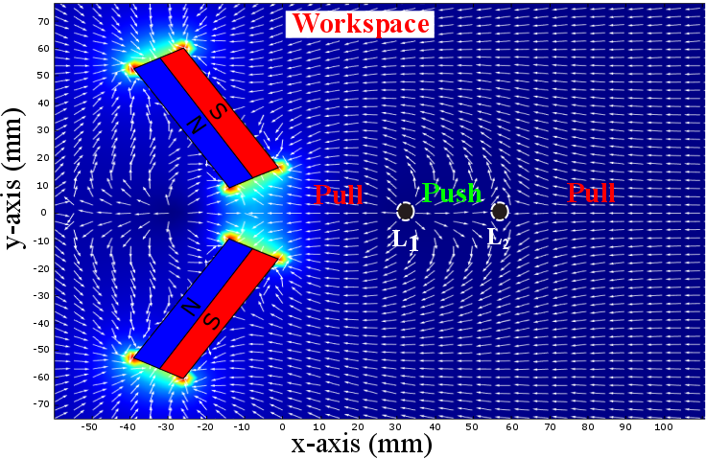
Results of finite element simulations
Finite elements simulation of the magnetic actuator:
Lagrangian nodes
Unstable
L₁
L₂
Stable
Magnets parameters:
- Length : 50mm
- Width : 15mm
- Thickness : 15mm
6
Notes:
Tu expliques que L1 est un point instable et L2 un point stable

Slide 7
Results of finite element simulations
An other solution is to use two permanent magnets generating both push and pull forces.
7
Notes:
Animation pour montrer que L2 est stable

Slide 8
Using a Two Permanent Magnet Actuator
Results of finite element simulations
An other solution is to use two permanent magnets generating both push and pull forces.
8

Slide 9
Using a Two Permanent Magnet Actuator
Results of finite element simulations
An other solution is to use two permanent magnets generating both push and pull forces.
9
Notes:
L1 instable

Slide 10
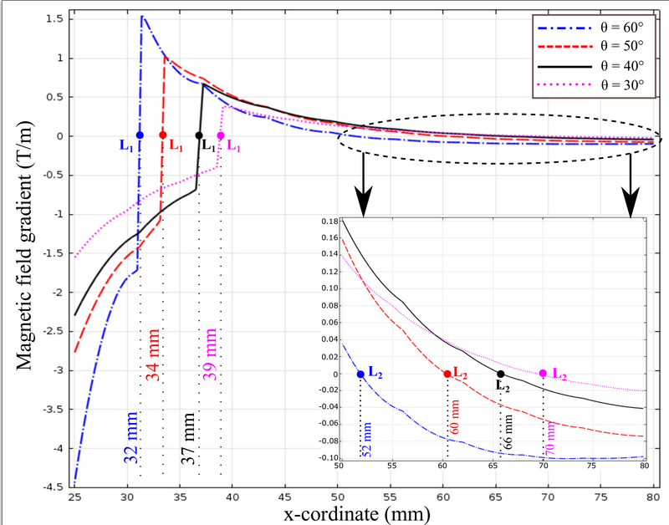
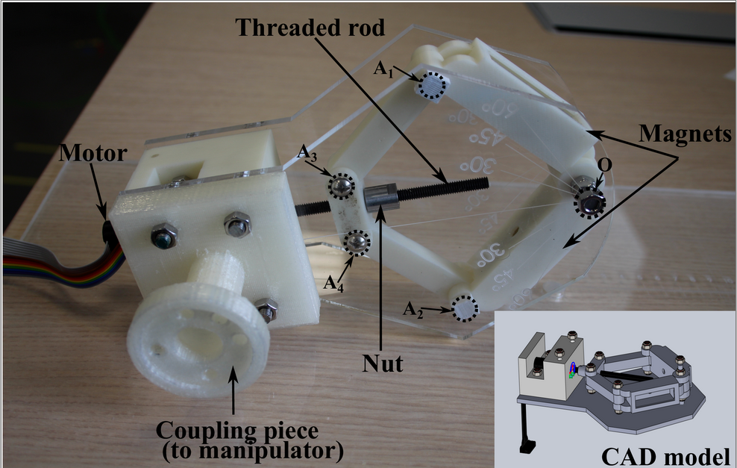
Results of finite element simulations
The tilting of permanent magnets changes the coordinates of Lagragian points
Permanent magnets are inclined with a fixed angle 𝛳 higher than 30° to prevent from repulsive magnetic force
10
Notes:
Tu dis que la motorisation de cette actionneur permet d’étendre l espace de travail. Et avec L2 ça permet de controler la particule.
Tu montres le prototype

Slide 11
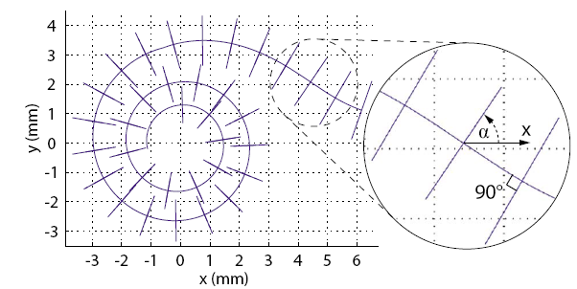
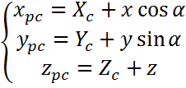
Planning the Trajectory of Scala-Pympani Channel
Planning the trajectory in the cochlea
Placement of the cross section along the length of the spiral curve.
L2_{i} : i^{th} stable Langragian position
L2₃
L2₂
L2₁
Pushing force
Linear segments
N
N
L2_{i}
L2_{i+1}
S
34 cross-sections
S
θ
11
L2_{i+2}
Pulling force
The microparticle is actuated with both push and pull force
The robot manipulator matches the axis of each linear segment
N
N
S
S
Notes:
Tu expliques ici la stratégie du push and pull:
Coupé la cochlée en plusieurs segment linéaire / match each linear segment with the magnetic actuator axis to push and pull by changing the tilting between magnets

Slide 12
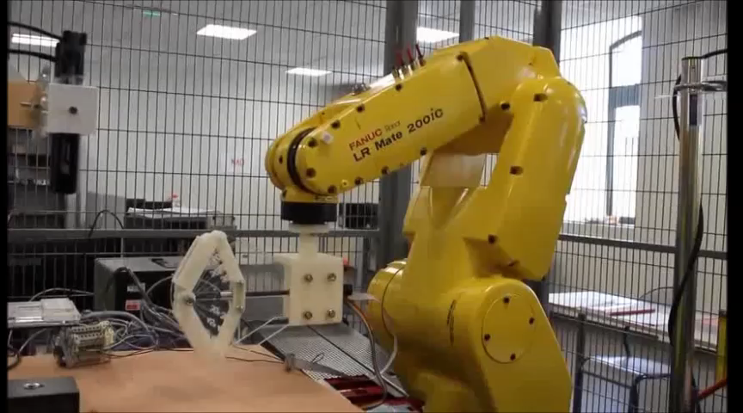
Experimental validation
Open loop control in a W-shaped canal :
12
Notes:
Y’a l explication dans la vidéo que tu reprends

Slide 13
Conclusion
A new motorized actuator based on two permanent magnets is proposed.
The magnetic actuator provides pushing and pulling force and can be coupled with a robotic manipulator.
The magnetic actuator creates a stable point in the workspace, which is used to steer particles through several trajectories
Future work will focus on evaluating the closed-loop control using inverse kinematics and dynamic model
13

Slide 14
Thank you !

